Slide 1

EXAMPLES OF DO WHILE..LOOP
Example 1 : Never executes loop
Dim A as Integer
A=10
Do While A>10
A=A-1
Loop
Example 2 : Executes loop
Dim P as Byte
P=10
Do While P>5
P=P-2
Loop

Slide 2
DO..LOOP WHILE
Do Loop While is an exit controlled loop as the condition is placed at exit point.
The body of the loop is going to be executed at least once whether the condition evaluates to true or false. Loop is executed as long as the result of the condition remains true.
Syntax :
Do
One or more VB Statements
Loop While <condition or Boolean Expression>

Slide 3
EXAMPLES
Example 1 :
Do
num = InputBox (“Enter a number”)
sum = sum + num
Loop While num < > 0
Here the statements inside the loop will be executed once no matter what the comparison test evaluates to.

Slide 4
DO..UNTIL LOOP
Do Until loop is an entry controlled loop in which the condition is placed at the entry point.
This loop executes the statements specified in the body of the loop till the condition evaluates to false.
The loop may not be executed at all the if the condition is initially true.
Syntax :
Do Until <condition or boolean expression>
‘ One or more VB Statements
Loop

Slide 5
EXAMPLES OF DO UNTIL..LOOP
Do Until condition
//statement
Loop

Slide 6
DO..LOOP UNTIL
Do Loop Until is an exit controlled loop as the condition is placed at exit point.
The body of the loop is going to be executed at least once whether the condition evaluates to true or false.
Loop is executed as long as the result of the condition remains false.
Syntax :
Do
One or more VB Statements
Loop Until <condition or Boolean Expression>

Slide 7
EXAMPLES
Example 1 :
Do
num = InputBox (“Enter a number”)
sum = sum + num
Loop Until num = 0
Here the statements inside the loop will be executed once no matter what the comparison test evaluates to.

Slide 8
WHILE..END WHILE
While..Wend loop is functionally equivalent to the Do While..Loop. It executes a set of VB statements till the condition evaluates to true.
Syntax :
While <Condition>
one or more vb statements
End While

Slide 9
EXAMPLE
Example 1 : Generate the sum of first 10 natural no’s
I = 1
While I<=10
Sum = Sum + I
I = I + 1
End While
MsgBox(“Sum of 10 natural no’s = ” ; Sum)

Slide 10
FOR EACH…NEXT
Syntax:-
For Each Element [As Data Type] In Group
‘one or more statements
Next [Element]
Example:-
Dim strEmployees As String() = {"Jim", "Sally", _
"Henry", “Tom", “Jack"}
Dim strName As String
For Each strName In strEmployees
MessageBox(strName)
Next strName

Slide 11
WITH...END WITH
It executes a series of statements making repeated reference to a single object or structure.
We can use a With...End With structure to specify the object once for all of the statements.

Slide 12
Syntax:-
With <object name>
.<property-name>=<value>
..
.<property-name>=<value>
End With
Example:-
With testObject
.Height = 100
.Text = "Hello World"
.ForeColor = System.Drawing.Color.Green
End With

Slide 13
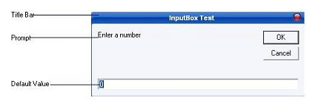
INPUTBOX METHOD
Displays a prompt in a dialog box, waits for the user to input value in textbox and button click, and then returns a value containing the contents of the text box.
Following is an expanded InputBox:-

Slide 14
Syntax :
variable-Name= InputBox(prompt[,title][,default][,XPos][,YPos)
Prompt - String expression displayed as the message in the dialog box. If prompt consists of more than one line, you can separate the lines using the vbCrLf constant
Title - String expression displayed in the title bar of the dialog box. If you omit the title, the application name is displayed in the title bar
default-text - The default text that appears in the input field where users can use it as his intended input or he may change to the message he wish to key in.

Slide 15
Xpos- Optional. Numeric expression that specifies, in twips, the distance of the left edge of the dialog box from the left edge of the screen. If you omit XPos, the dialog box is centered horizontally.
Ypos- Optional.Numeric expression that specifies, in twips, the distance of the upper edge of the dialog box from the top of the screen. If you omit YPos, the dialog box is positioned vertically approximately one-third of the way down the screen.

Slide 16
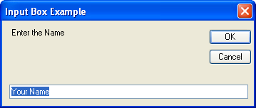
EXAMPLE
InputBox("Enter the Name", "Input Box Example", "Your Name")

Slide 17
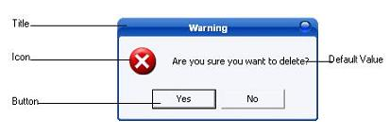
MSGBOX & MESSAGEBOX.SHOW METHOD
Displays a message in a dialog box and wait for the user to click a button, and returns an integer indicating which button the user clicked.

Slide 18
The message box function you have used so far is the old message box function. It is the one left over form VB6:
MsgBox("Your Message Here")
The new VB.NET message box function is very similar, but the way you use it is slightly different. It's this:
MessageBox.Show("Your Message Here")

Slide 19
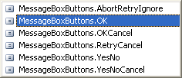
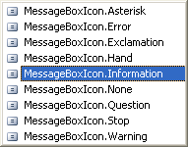
Syntax :
MessageBox.Show ( Prompt [,icons + buttons ] [,title ] )
Prompt : String expressions displayed as the message in the dialog box. If prompt consist of more than one line, you can separate the lines using the vbrCrLf constant.
Icons + Buttons : specifying the type of buttons and icon to display.

Slide 20
Title : String expression displayed in the title bar of the dialog box. If you omit title, the application name is placed in the title bar.
In a real programme, you should use the new MessageBox.Show( ) function, rather than the MsgBox() we used (and will again because it saves on typing and space!)

Slide 21
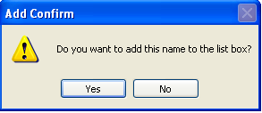
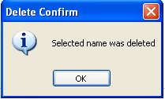
Example 1:-
MessageBox.Show("Do you want to add this name to the list box?", MessageBoxButtons.YesNo,MessageBoxIcons.Error, "Add Confirm")
Example 2:-
MessageBox.Show("Selected name was deleted", MessageBoxIcon.Information , "Delete Confirm“)

Slide 22
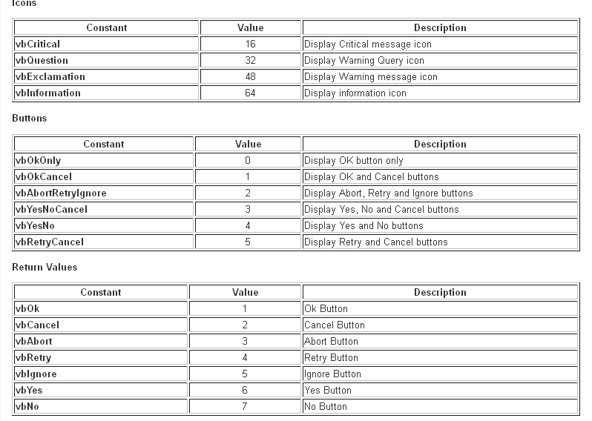

Slide 23
SIMILARITY BETWEEN VB & VB.NET
Both languages support the creation of windows form application with the help of Graphical User Interface.
Both languages support event driven programming.
Both are provided with the IntelliSense feature.

Slide 24
DIFFERENCE BETWEEN VB AND VB.NET
VB | VB.NET
It supports Unstructured exception handling. | It supports Structured as well as Unstructured exception handling.
VB is object based. It doesn't support Inheritance and polymorphism. It supports interfaces in an awkward way. | VB.Net is object oriented. It supports Inheritance and polymorphism. It fully supports interface-based programming.
VB doesn’t support multithreading. | VB.Net supports multithreading.
Components created in VB6 (COM) need to make and update registry entries. | VB.NET does not require any registry entry making the deployment easier.

Slide 25
DIFFERENCE BETWEEN VB AND VB.NET
VB | VB.NET
VB is interpreted language. | VB.Net is compiled language
VB is an Unmanaged Language. It is not supported by the feature of CLR. | VB.Net is a Managed Language. It has a support of CLR feature.
Dim x, y as Integer. VB will consider x as Variant and y as Integer. By default, the variable is variant. VB was not a type-safe language. | Dim x, y as Integer. VB.Net will declare x and y both as Integer By default, the variable is object. VB.NET is a type safe language.

Slide 26
DIFFERENCE BETWEEN VB AND VB.NET
VB | VB.NET
ByRef is default. | ByVal is the default.
It does not support feature of Garbage Collection. | It supports feature of Garbage Collection.
It supports recordset and ADO for database connectivity. | It supports ADO.NET for database connectivity.
VB was only considered good for desktop windows application. | In VB.NET you can also develop web applications, distributed applications, create .NET windows and web controls and components, write windows and web services.

Slide 27
ENUMERATIONS
An enumeration is a list of integer values, each one mapped to a name or we can say that it consist of a set of a named constant called as Enumeration List.
Every enumeration has an underlying type which can be any integral type (Sbyte,Byte,Short,Ushort,Integer,UInteger, Long,ULong,Byte,Char)
Default data type is Integer.

Slide 28
ENUMERATIONS
Syntax: Enum <enumeration-name> [As] [Integral Data type] enumeration-list End Enum
Example Enum Days
Sunday
Monday
Tuesday
Wednesday
Thursday
Friday
Saturday
End Enum
MessageBox.show(Days.Tuesday) ‘Output: 2

Slide 29
ENUMERATIONS
Visual Basic initializes the first member with value 0 if no value is given to it followed by an (n+1) progression.
Enumerations do not necessarily need to follow a sequential ordering.
For Example:-
Enum BoilingPoints As Byte
Fahrenheit = 212
Celcius = 100
End Enum
Values of enumeration can repeat.

Slide 30
ARRAY
An array is a collection of same-type data that are stored contiguously and are accessible by an index or subscript.
Arrays in Visual Basic .NET inherit from the Array class in the System namespace.
Index of the first element is 0 and they are numbered sequentially.
An array can have any dimension (one dimension (linear arrays) or more than one (multidimensional arrays).

Slide 31
DECLARING ONE-DIMENSIONAL ARRAY
Declaring an array specifying the number of elements
<Dim | Access-Modifier> arrayname(highestSubscript) As datatype
Dim students(5) As String ‘Array of 6 elements of string type
Private cities() As String = {“Delhi”, “Lucknow”, “Mumbai”}

Slide 32
THE FOLLOWING CODE DEMONSTRATES ARRAYS
Dim sport(5) As String 'declaring an array
sport(0) = "Soccer“ 'storing values in the array sport(1) = "Cricket" sport(2) = "Rugby" sport(3) = "Aussie Rules" sport(4) = "BasketBall" sport(5) = "Hockey“
MsgBox("Name of the Sport in the third location" _
& " " & sport(2)) ‘printing the specific value

Slide 33
ARRAYS AND LOOPS
Dim a(9) as Integers
Dim Count As Integer
For Count = 0 To 9
a(Count)=InputBox("Enter number")
Next
For Count = 0 to (a.Length – 1)
MsgBox(a(Count))
Next

Slide 34
DYNAMICALLY RESIZING AN ARRAY
ReDim [Preserve] Arrayname(UpperSubscript)
Example:-
Dim Test(10) as Integer
ReDim Test(25) as Integer
ReDim Preserve Test(25) as Integer

Slide 35

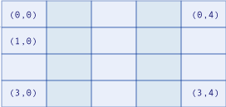
MULTIDIMENSIONAL ARRAYS -RECTANGULAR ARRAYS
One-dimensional array
Dim a(3) As Integer
Two-dimensional array
Dim a(3,4) As Integer
Dim a(,) As Integer = {{75, 90}, {9, 25}, {23, 56}, {6, 12}}
VB.Net allows arrays of up to 32 dimensions

Slide 36

MULTIDIMENSIONAL ARRAYS -JAGGED ARRAYS
Dim colors(1)() as String 'declaring an array of 2 arrays
colors(0)=New String(){"Red","blue","Green"}
'initializing the first array to 3 members
colors(1)=New String(){"Yellow"}
'initializing the second array to 1 members

Slide 37
ARRAYLIST
An ArrayList is a dynamic array i.e.; at run time we can increase or decrease it size.
ArrayList is one of the most flexible data structure from Collections.
ArrayList contains a list of values and very easily we can add , insert , delete , view etc.
<Dim|Access-Modifier> <ArrayList-Name> As New ArrayList
Example; Dim mylist As New ArrayList

Slide 38
IMPORTANT FUNCTION IN ARRAYLIST
Add : Add an Item in an Array List
Insert : Insert an Item in a specified position in an Array List
Remove : Remove an Item from ArrayList
RemoveAt: remove an item from a specified position
Sort : Sort Items in an Array List

Slide 39
To add the item in ArrayList: myList.Add(“red")
To Insert Items in an ArrayList: mylist.Insert(3, “blue")
To remove an item from arrayList: myList.Remove(“red")
To remove an item in a specified position from an ArrayList: myList.RemoveAt(3)
To sort ArrayList: myList.Sort()

Slide 40
ARRAY PROPERTIES
Length- Return the length(total number of element) of a one-dimensional array in integer.
Syntax: Arrayname.Length
Rank- Return number of dimension of array.
Syntax: Arrayname.Rank

Slide 41
PROCEDURES AND ITS TYPES
There are 3 types of Procedures in .NET :-
Sub Procedures:- Perform actions but don't return a value to calling code.
Function Procedures:- Return a value to the calling code.
Property Procedures:- Return and assign values of properties on object.

Slide 42
SUB PROCEDURES
A sub procedure is a series of statements enclosed by the Sub and End sub statements.
The sub procedure performs a task and then returns control to the calling code, but it doesn't return a value to the calling code.

Slide 43
SUB PROCEDURES- CALLING SUB PROCEDURE
Sub ShowMessage()
MessageBox.Show ("Press Enter to continue...“)
End Sub
Public Form1_Load()
ShowMessage()
End Sub

Slide 44
SUB PROCEDURES
We can define a sub procedure in module, classes and structures.
By default it is Public.

Slide 45
SUB PROCEDURES
Syntax
[{ Overloads | Overrides | Overridable |
NotOverridable | MustOverride | Shared }]
[{ Public | Protected | Friend | Protected Friend | Private }]
Sub name [(arglist)]
[ Implements interface.definedname ]
statements
[ Exit Sub ]
statements
End Sub

Slide 46
SUB PROCEDURES- TYPES OF ARGUMENTS
ByVal—Specifies passing by value. ByVal is the default in Visual Basic.Net. Here copy of the data will be passed to the procedure.
ByRef—Specifies passing by reference, which means the procedure code can modify the value of the original variable in the calling code because here location of the data in memory will be passed to the procedure.

Slide 47
SUB PROCEDURES- TYPES OF ARGUMENTS
Optional—Specifies that this argument is not required when the procedure is called. If you use this keyword, all following arguments in arglist must also be optional and be declared using the Optional keyword. Every optional argument declaration must supply a defaultvalue.
ParamArray-allows you to pass an arbitrary number of arguments to the procedure. ParamArray arguments are always passed by value.

Slide 48
OPTIONAL
Sub MyMethod(ByVal Param1 As String, Optional ByVal FlagArgument As Boolean = True)
If FlagArgument Then 'Do something special Console.WriteLine(Param1)
End If
End Sub
Sub main()
MyMethod("test1")
MyMethod("test2", False)
End Sub

Slide 49
PARAMARRAY
Module ParamArrayTest
Sub ShowThings(ParamArray MyThings() As Integer) For Each thing As Integer In MyThings console.writeline(thing)
Next
End Sub
Sub Test()
ShowThings(3, 4, 5)
ShowThings()
End Sub
End Module

Slide 50
FUNCTION
A Function procedure is a series of statements enclosed by the Function and End Function statements.
A Function performs a task and then returns control to the calling code. When it returns control, it also returns a value to the calling code.
We can define a Function in module, classes and structures.
By default it is Public.

Slide 51
FUNCTION-SYNTAX
[{ Overloads | Overrides | Overridable |
NotOverridable | MustOverride | Shared }]
[{ Public | Protected | Friend | Protected Friend |
Private }] Function name[(arglist)] [ As type ]
[ Implements interface.definedname ]
statements
[ Exit Function ]
statements
End Function

Slide 52
CALLING FUNCTION
Public Function Add(ByVal x1 as Integer, ByVal y1 as Integer) As Integer // Implementation End Function
Public Form1_Load()
Add()
End Sub

Slide 53
FUNCTION
Function FindMax(ByVal num1 As Integer, ByVal num2 As Integer) As Integer
Dim result As Integer
If (num1 > num2) Then
result = num1
Else
result = num2
End If
FindMax = result
End Function
Sub Main()
Dim a As Integer = 100, b As Integer = 200, res As Integer
res = FindMax(a, b)
Console.WriteLine("Max value is : {0}", res)
Console.ReadLine()
End Sub

Slide 54
FUNCTION
Function factorial(ByVal num As Integer) As Integer
Dim result As Integer
If (num = 1) Then
Return 1
Else
result = factorial(num - 1) * num
Return result
End If
End Function
Sub Main() 'calling the factorial method Console.WriteLine("Factorial of 6 is : {0}", factorial(6)) Console.ReadLine()
End Sub

Slide 55
FUNCTION
Function AddElements(ParamArray arr As Integer()) As Integer
Dim sum As Integer = 0
Dim i As Integer = 0
For Each i In arr
sum += i
Next
Return sum
End Function
Sub Main()
Dim sum As Integer
sum = AddElements(512, 720, 250, 567, 889) Console.WriteLine("The sum is: {0}", sum) Console.ReadLine()
End Sub

Slide 56
EXCEPTION HANDLING
Error happens at compile time.
Exception happens at run time.
Two-types of exceptional handling are:-
Unstructured Exception Handling
Structured Exception Handling

Slide 57
UNSTRUCTURED EXCEPTION HANDLING
Unstructured exceptional handling uses “On Error GoTo………” statement for handling the execution.
Syntax:
On Error {GoTo [line|0|-1]} Resume [Next| label]}

Slide 58
UNSTRUCTURED EXCEPTION HANDLING
GoTo line
Calls the error-handling code that starts at the line specified at line.
Here, line is a line label or a line number.
If a runtime error occurs, program execution goes to the given location.
GoTo 0
Turning off exceptional handling
GoTo -1
Same as GoTo 0

Slide 59
UNSTRUCTURED EXCEPTION HANDLING
Resume {Next|label}
Resume Next Specifies that when a run-time error occurs, control goes to the statement immediately following the statement where the error occurred, and execution continues from that point.
Resume <label> causes code execution to resume at a line label. This allows you to skip a section of code if an error occurs.

Slide 60
UNSTRUCTURED EXCEPTION HANDLING
How to use the On Error GoTo statement
Public Class Form1
Sub procedure-Name([Argument])
On Error GoTo Handler
//statements
Handler:
//statments
End Sub
End Module

Slide 61
EXAMPLE
On Error GoTo Handler
Dim a As Integer
a = InputBox("Enter 1st Number")
Dim b As Integer = 128
Dim Result As Integer
Result = b / a
console.writeline("Result is " & Result)
console.readline()
Handler:
console.writeline("An overflow error occurred.")
console.readline()

Slide 62
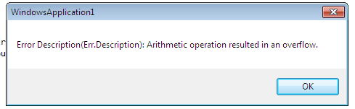
EXAMPLE
On Error GoTo Handler
Dim a As Integer
a = InputBox("Enter 1st Number")
Dim b As Integer = 128
Dim Result As Integer
Result = b / a
console.writeline("Result is " & Result)
console.readline()
Handler:
MsgBox("Error Description: " & Err.Description )

Slide 63
EXAMPLE
On Error Resume Next
Dim a As Integer
a = InputBox("Enter 1st Number")
Dim b As Integer = 128
Dim Result As Integer
Result = b / a
console.writeline("Result is " & Result)
console.readline()

Slide 64
STRUCTURED EXCEPTION HANDLING
In Visual Basic .NET, structured exception handling centers on the Try/Catch statement.
In this statement, you put sensitive, exception-prone code in a Try block, and if an exception occurs, the code in the Try block will throw the exception implicitly (actually an exception object), which will then be caught by a following Catch block. The code in the Catch block handles the exception.

Slide 65
STRUCTURED EXCEPTION HANDLING
Try
[ tryStatements ]
Catch [ exception1 [ As type1 ] ] [ When <expression1> ]
// catchStatements1
[Exit Try]
[Catch [ exception2 [ As type2 ] ] [When <expression2> ]
// catchStatements2
[ Exit Try ]
[ Finally]
finallyStatements
End Try

Slide 66
EXAMPLE
Dim a As Integer
a=InputBox(“Enter First Number”)
Dim b As Integer = 128
Dim Result As Integer
Try
Result = b / a
MsgBox("The answer is " & Result)
MsgBox("Press Ok to continue...")
Catch
MsgBox("An overflow exception occurred.")
MsgBox("Press Ok to continue...")
End Try
End Sub

Slide 67
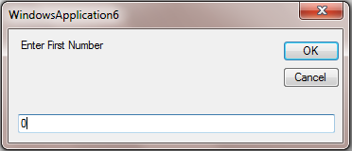
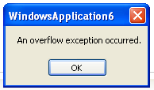
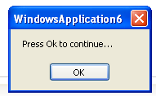
OUTPUT

Slide 68
EXAMPLE
Dim a As Integer
a=InputBox(“Enter First Number”)
Dim b As Integer = 128
Dim Result As Integer
Try
Result = b / a
MsgBox("The answer is " & Result)
MsgBox("Press Ok to continue...")
Catch ex As Exception
MsgBox(ex.Message)
MsgBox("Press Ok to continue...")
End Try
End Sub

Slide 69
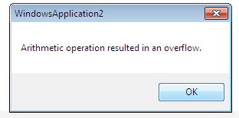
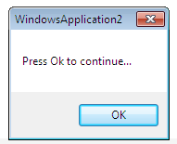
OUTPUT

Slide 70
EXAMPLE
Dim a As Integer
a=InputBox(“Enter First Number”)
Dim b As Integer = 128
Dim Result As Integer
Try
Result = b / a
MsgBox("The answer is " & Result)
MsgBox("Press Ok to continue...")
Catch myException As OverflowException
MsgBox(myException.Message)
MsgBox("Press Ok to continue...")
Catch myException As OutOfMemoryException
MsgBox(myException.Message)
MsgBox("Press Ok to continue...")
Finally
MsgBox("This code will always run")
End Try
End Sub

Slide 71
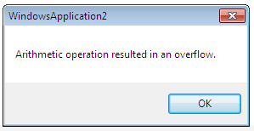
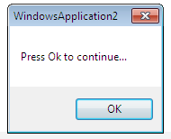
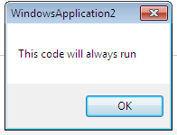
OUTPUT

Slide 72
CREATING AND THROWING CUSTOM EXCEPTIONS
We can, in fact, customize and create our own exceptions. To do that, we throw an exception using the ApplicationException object.
Try
Throw New ApplicationException ("We threw here custom exception")
Catch myexception As Exception
MessageBox.Show(myexception.Message)
Finally
MessageBox.Show("Press Ok to continue...")
End Try

Slide 73
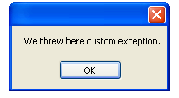
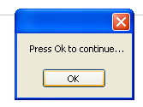
OUTPUT

